Slide 1

MongoDB
Team# 7
Shubham Vadhera | Sagar Dafle | Jagmohan Singh |Pooja Yelure

Slide 2




MongoDB Design Philosophy
Combining the critical capabilities of relational databases with the innovations of NoSQL technologies
RELATIONAL
NoSQL
MongoDB Architecture Guide
https://www.google.com/imghp

Slide 3
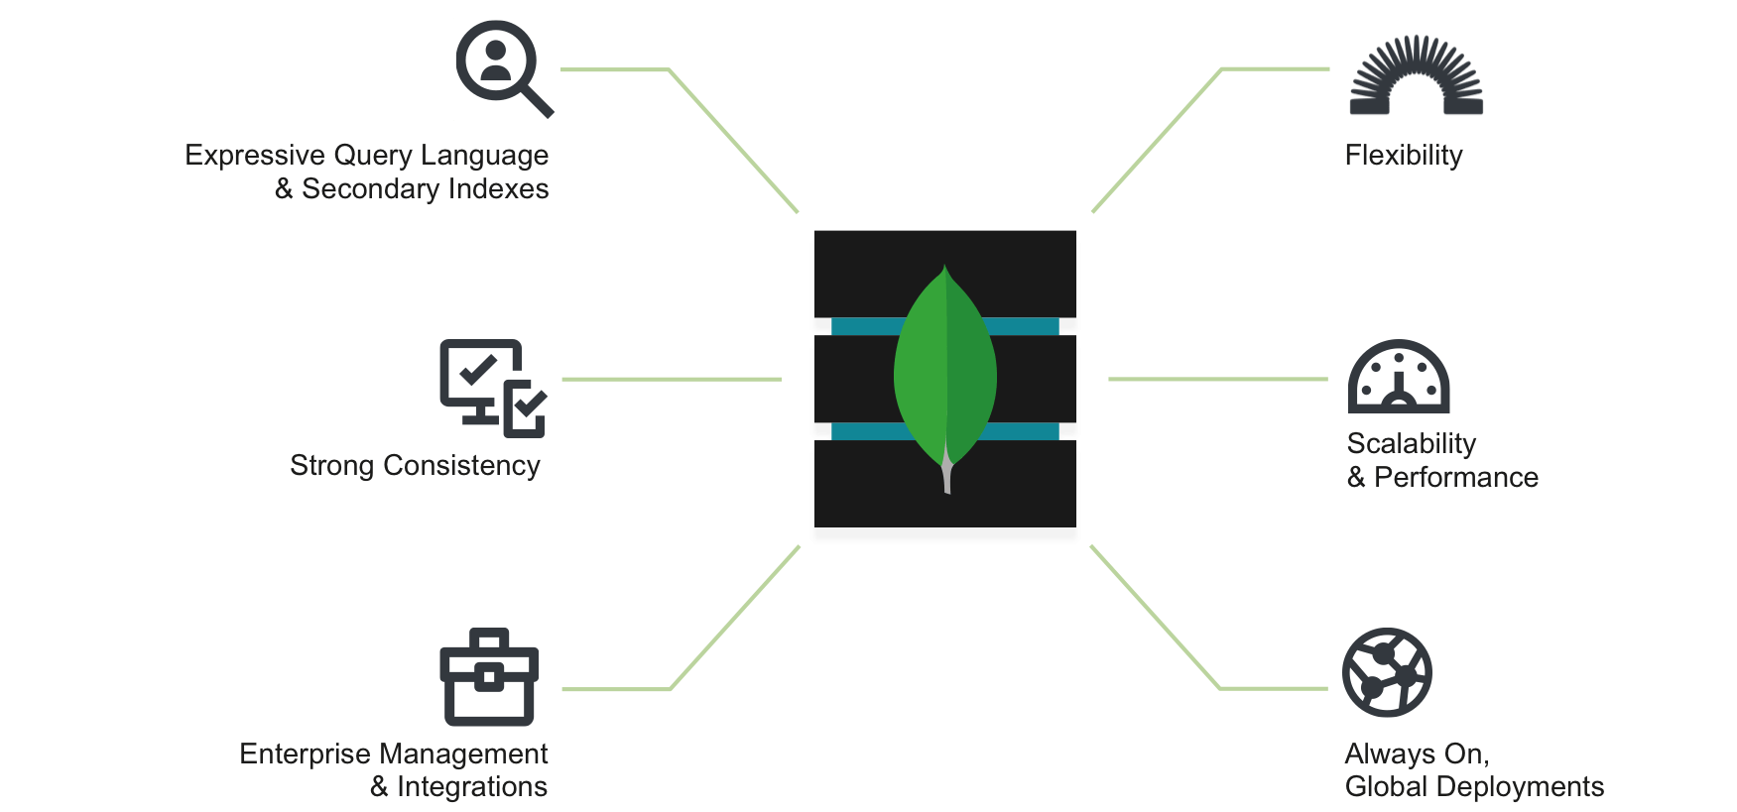
Mongo DB !
https://www.mongodb.com/mongodb-architecture

Slide 4
Traditional DB – Relational DB
Expressive query language - Users should be able to access and manipulate their data in sophisticated ways
Strong consistency - Applications should be able to immediately read what has been written to the database
Enterprise Management and Integrations - A database should allow administrators to secure, monitor, automate, and integrate with their existing technology infrastructure
MongoDB Architecture Guide

Slide 5
Modern DB – NoSQL DB
Flexible Data Model - Easy to store and combine data of any structure
Scalability and Performance - Enable almost unlimited growth with higher throughput and lower latency than relational databases.
Always-On Global Deployments – Available systems across many nodes
MongoDB Architecture Guide

Slide 6
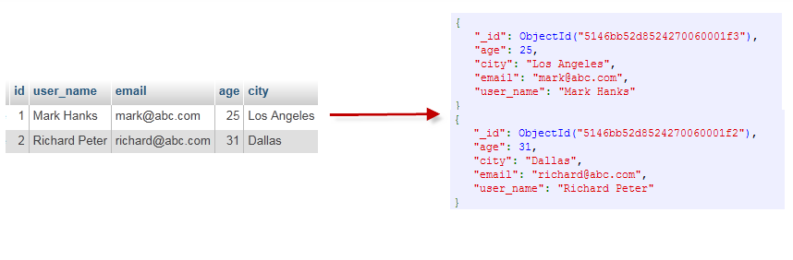
MongoDB Data Model
Data As Documents
MongoDB stores data as documents in a binary representation called BSON (Binary JSON)
BSON extends the popular JSON (JavaScript Object Notation) representation to include additional types such as int, long, date, and floating point
Documents that tend to share a similar structure are organized as collections
MongoDB Architecture Guide
https://cdn.tutsplus.com/net/uploads/2013/11/Figure-1-Mapping-Table-to-Collection-1.png

Slide 7
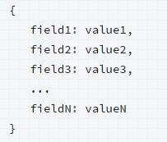
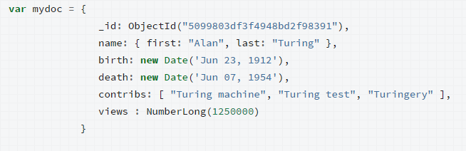
MongoDB Data Model
MongoDB documents are composed of field-and-value pairs and have the following structure:
https://docs.mongodb.org/manual/core/databases-and-collections/#collections

Slide 8
MongoDB Data Model
Dynamic Schema
Fields can vary from document to document
There is no need to declare the structure of documents to the system –documents are self describing
Document Validation
Users can enforce checks on document structure, data types, data ranges and the presence of mandatory fields
MongoDB Architecture Guide

Slide 9
Key Market Features (Pros) of MongoDB
High availability (by replicating the data)
Scalability (from a standalone server to distributed architectures of huge clusters). This allows us to shard our database transparently across all our shards. This increases the performance of our data processing.
Aggregation: Batch data processing and aggregate calculations using native MongoDB operations.
Load Balancing: Automatic data movement across different shards for load balancing. The balancer decides when to migrate the data and the destination Shard, so they are evenly distributed among all servers in the cluster.
http://www.mongodbspain.com/en/2014/08/17/mongodb-characteristics-future/

Slide 10
Why MONGO over other NoSQL DBs
MongoDB Management Service (MMS) is a powerful web tool that allows us tracking our databases and our machines and also backing up our data.
MMS tracks the database and hardware metrics for managing mongodb deployment.
Custom alerts: Discover issues before your MongoDB instance will be affected.
Task Automation: Simple launch and configuration of standalone MongoDB instances, replica sets or sharded clusters.
http://www.mongodbspain.com/en/2014/08/17/mongodb-characteristics-future/

Slide 11
CONS of Mongo DB
Less Flexibility with querying (e.g. no JOINs)
Memory Usage MongoDB has the natural tendency to use up more memory because it has to store the key names within each document.
Concurrency Issues When you perform a write operation in MongoDB, it creates a lock on the entire database, not just the affected entries, and not just for a particular connection. This lock blocks not only other write operations, but also read operations.
http://halls-of-valhalla.org/beta/articles/the-pros-and-cons-of-mongodb,45/

Slide 12
Optimal use cases of Mongo
Usually used when we need a horizontally scalable performance for high loads.
Real-time analytics and high-speed logging, caching and high scalability.
RDBMS replacement for web applications.
With 1.5 million new classified ads posted every day, Craigslist must archive billions of records in many different formats, and must be able to query and report on these archives at runtime.
https://www.mongodb.com/customers/craigslist

Slide 13
CRUD Operations
Read Operations: Queries are the core operations that return data in MongoDB.
Cursors: Queries return iterable objects, called cursors, that hold the full result set.
Write operations: Insert, update, or remove documents in MongoDB. Introduces data create and modify operations, their behavior, and performances.
Atomicity and Transactions: Describes write operation atomicity in MongoDb.

Slide 14
CRUD Operations
Commands Used to Create Document:
db.collection.insert()
db.collection.insertOne();
db.collection.insert();
Example to Insert Query: db.bank_data.insertOne({"first_name" : "John", "last_name" : "Cena", "accounts" : [ { "account_type" : "Investment", "account_balance" : 6123524974.110823463, "currency" : "USD" }, { "account_type" : "Savings", "account_balance" : 132933272.569229168, "currency" : "EURO" } ]});
Command Used to Read Documents:
db.collection.find();
Db.collection.findOne();
Example for reading : db.bank_data.findOne({"last_name":"SMITH"});
Projections: In Mongo DB projection meaning is selecting only necessary data rather than selecting whole of the data of a document
$
$elemMatch
$limit
Example: db.bank_data.findOne({"last_name":"Cena"},{"first_name":1,"_id":0});

Slide 15
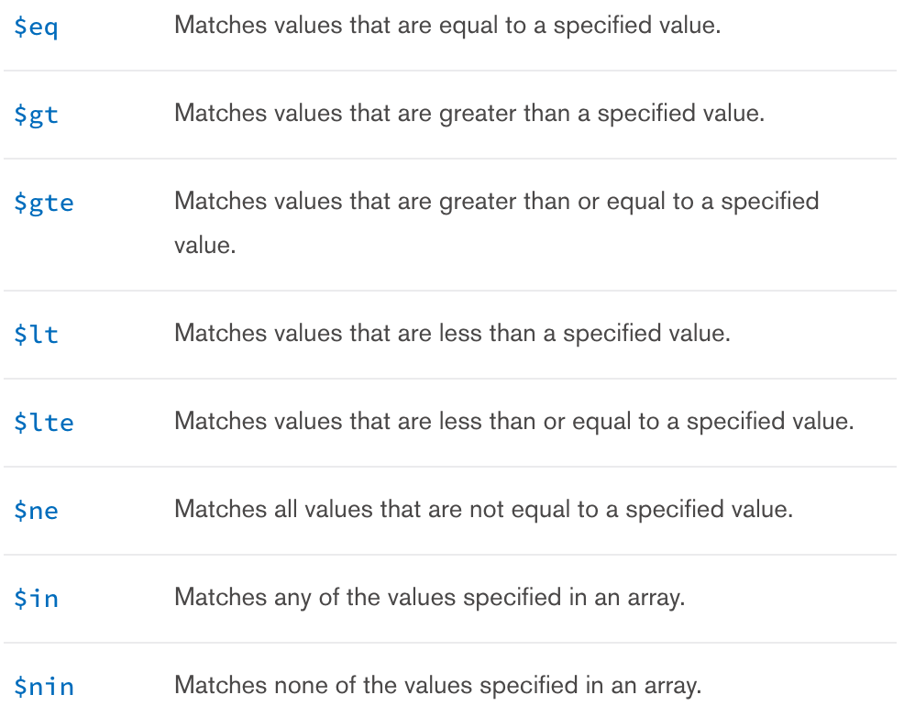
Comparison Operators
Example: $eq: db.bank_data.find({ "accounts.account_balance": {$eq:132933272.569229168}}).pretty()
$gte,$lte: db.bank_data.find({ "accounts.account_balance": {$gte:8554996,$lte:9000000}}).pretty()[4];

Slide 16
Logical Operators
Name | Description
$or | Joins query clauses with a logical OR returns all documents that match the conditions of either clause.
$and | Joins query clauses with a logical AND returns all documents that match the conditions of both clauses.
$not | Inverts the effect of a query expression and returns documents that do not match the query expression.
$nor | Joins query clauses with a logical NOR returns all documents that fail to match both clauses.
Examples:
$and db.bank_data.find({$and:[{"accounts.account_type":"Checking"}, { "accounts.account_balance": {$gte:8554996,$lte:9000000}}]}).pretty()[4];
$or db.bank_data.find({$and:[{"accounts.account_type":"Investment"},{"accounts.account_type":"Savings"}]}).pretty()[4];

Slide 17
Array and Regex Operator
Name | Description
$all | Matches arrays that contain all elements specified in the query.
$elemMatch | Selects documents if element in the array field matches all the specified $elemMatchconditions.
$size | Selects documents if the array field is a specified size.
Example $elemMatch: db.bank_data.find({last_name: "SMITH", "accounts.account_type": "Savings" }, { first_name: 1, last_name: 1, accounts: { $elemMatch : { 'account_type' : 'Savings' } } } ).pretty();
$regex: Provides regular expression capabilities for pattern matching strings in queries. MongoDB uses Perl compatible regular expressions (i.e. “PCRE” ) version 8.38 with UTF-8 support.
Example: db.bank_data.find({"first_name":{$regex:/^RI.*/}},{"first_name":1,"last_name":1,"_id":0}).pretty();

Slide 18
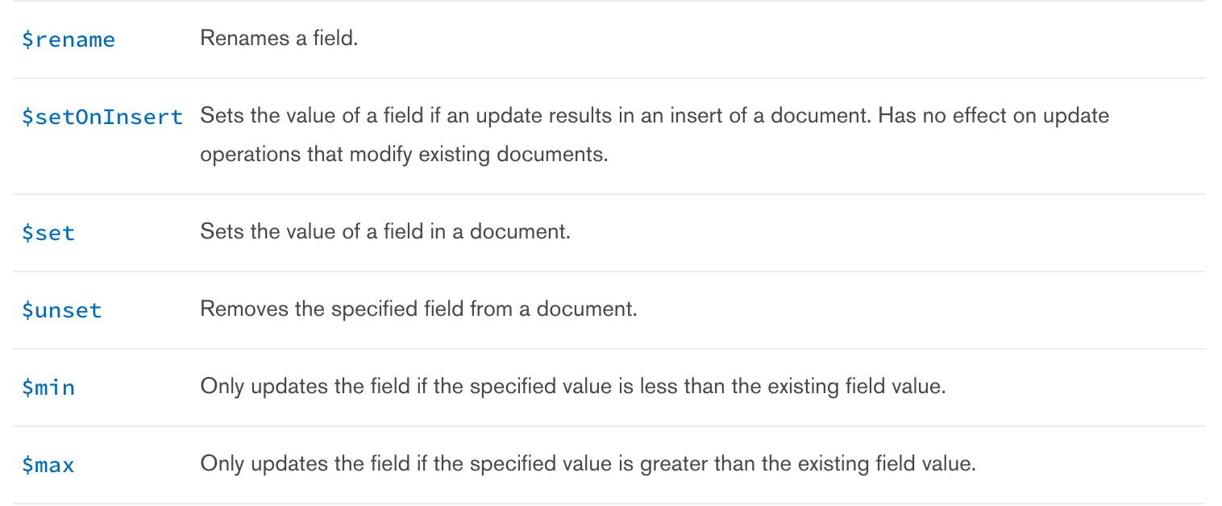
Update and Remove Queries
MongoDB's update() and save() methods are used to update document into a collection. The update() method update values in the existing document while the save() method replaces the existing document with the document passed in save() method.
MongoDB's remove() method is used to remove document from the collection. remove() method accepts two parameters. One is deletion criteria and second is justOne flag
Example: db.collection.remove({”last_name”:”SMITH”});

Slide 19
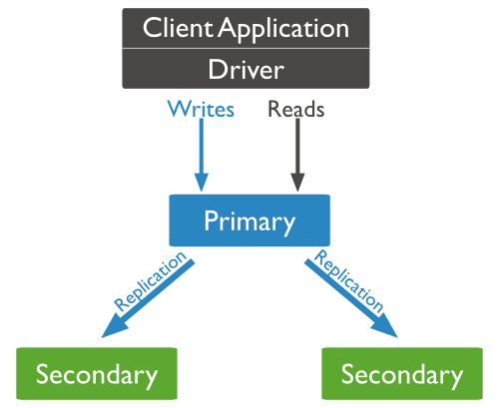
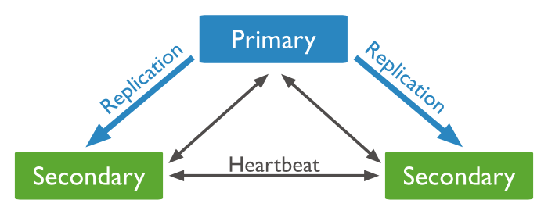
Replication Architecture
Replication set – multiple mongod instances
Upto 50 secondary allowed
Primary authoritative node
Read
Writes
Secondary nodes
Reads
At most 12 replica sets are allowed.

Slide 20
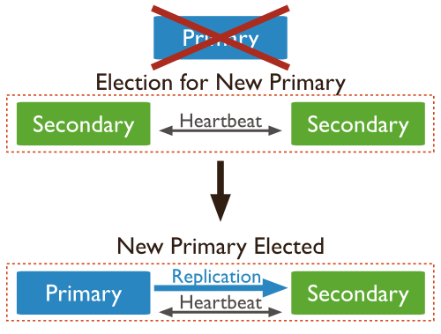
Automatic Failover
https://docs.mongodb.org/manual/core/replica-set-members/

Slide 21
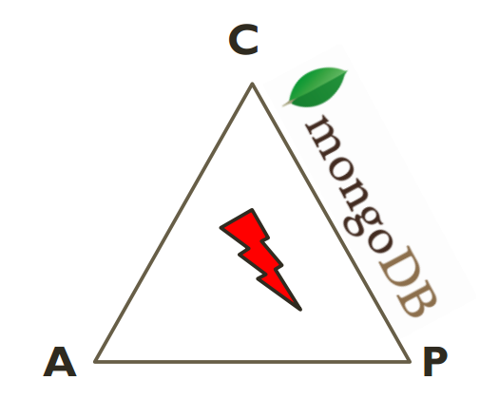
Partition Tolerance
http://www.ccs.neu.edu/home/kathleen/classes/cs3200/20-NoSQLMongoDB.pdf

Slide 22
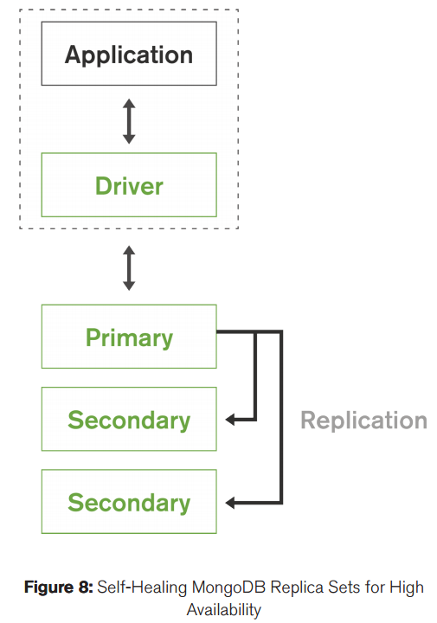
How does MongoDB solve the CAP?
CP System
Write Concern?
Lets you choose when was a write successful. Acknowledgements like
error ignored
How many nodes must have write acknowledged.
Read Preferences:
Allows you to choose where to read from.
Master / Slave
http://s3.amazonaws.com/info-mongodb-com/MongoDB_Architecture_Guide.pdf

Slide 23
For Write
a write quorum can be implemented using write concern.
if number of available nodes < specified in write concern, write operation will fail.
All read operations sent to the primary are consistent to last write operations.
Reads to a primary have strict consistency
• Reads reflect the latest changes to the data
• Reads to a secondary have eventual consistency
• Updates propagate gradually
• If clients permit reads from secondary sets – then client may read a previous state of the database.
http://www.ccs.neu.edu/home/kathleen/classes/cs3200/20-NoSQLMongoDB.pdf

Slide 24
References
http://jandiandme.blogspot.de/2013/06/mongodb-and-cap-theorem.html
http://stackoverflow.com/questions/7339374/nosql-what-does-it-mean-for-mongodb-or-bigtable-to-not-always-be-available
http://www.ccs.neu.edu/home/kathleen/classes/cs3200/20-NoSQLMongoDB.pdf
https://docs.mongodb.org/manual/core/replica-set-members/
https://github.com/sedouard/mongodb-mva

